Slide 1
Python Interview Questions
Designed by: Syed M. Raahim Taqvi

Slide 2
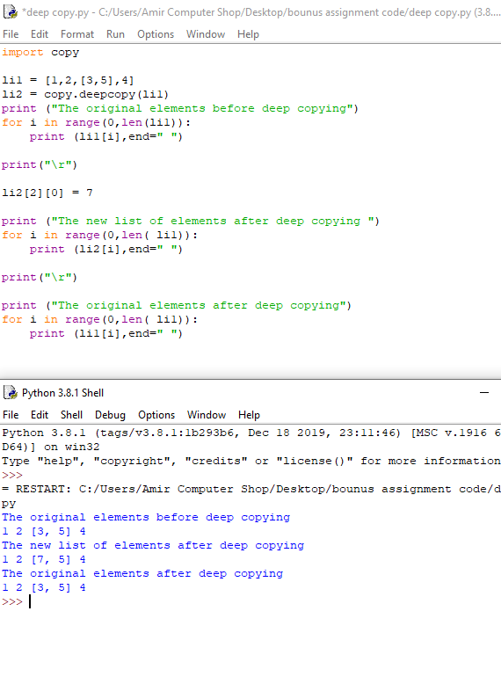
What is the difference between copy and shallow copy?
A copy is sometimes needed so one can change one copy without changing the other. In Python, there are two ways to create copies,
1) Deep copy
Deep copy is a process in which the copying process occurs recursively. It means first constructing a new collection object and then recursively populating it with copies of the child objects found in the original. In case of deep copy, a copy of object is copied in other object. It means that any changes made to a copy of object do not reflect in the original object. In python, this is implemented using “deepcopy()” function.

Slide 3
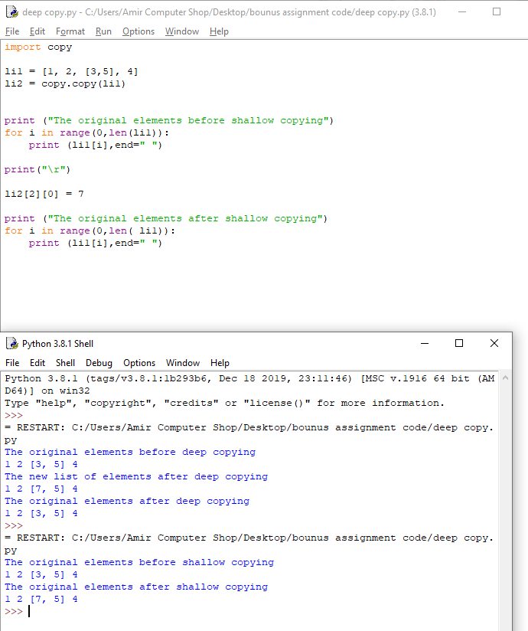
2) Shallow Copy
A shallow copy means constructing a new collection object and then populating it with references to the child objects found in the original. The copying process does not recurse and therefore won’t create copies of the child objects themselves. In case of shallow copy, a reference of object is copied in other object. It means that any changes made to a copy of object do reflect in the original object. In python, this is implemented using “copy()” function.

Slide 4
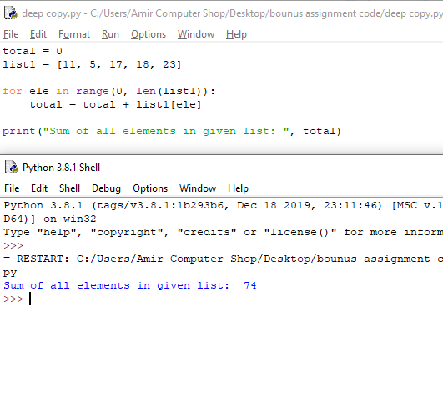
Q2.what is the difference between list and tuples?
List and Tuple in Python are the class of data structure. The list is dynamic, whereas tuple has static characteristics.
List
  list are just like the arrays, declared in other languages. Lists need not be homogeneous always which makes it a most powerful tool in Python. In Python, the list is a type of container in Data Structures, which is used to store multiple data at the same time. Lists are a useful tool for preserving a sequence of data and further iterating over it.

Slide 5
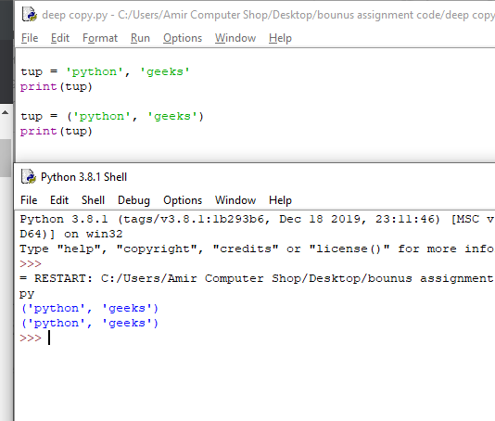
Tuples
Tuple is also a sequence data type that can contain elements of different data types, but these are immutable in nature. In other words, a tuple is a collection of Python objects separated by commas. The tuple is faster than the list because of static in nature.

Slide 6
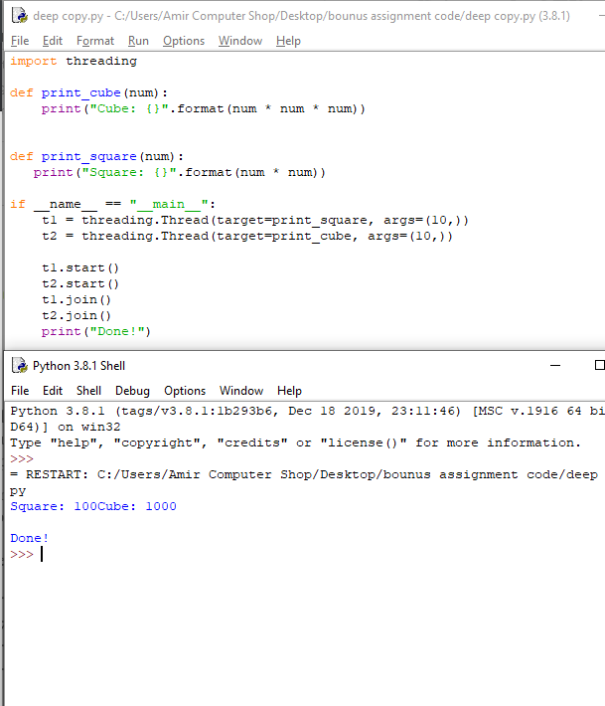
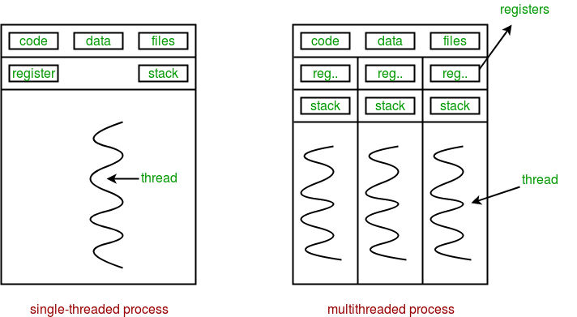
Q3.How multithreading is achieved in Python?
This article covers the basics of multithreading in Python programming language. Just like multiprocessing, multithreading is a way of achieving multitasking. In multithreading, the concept of threads is used.
Multiple threads can exist within one process where each thread contains its own register set and local variables (stored in stack).All thread of a process share global variables (stored in heap) and the program code, Consider the diagram below to understand how multiple threads exist in memory

Slide 7
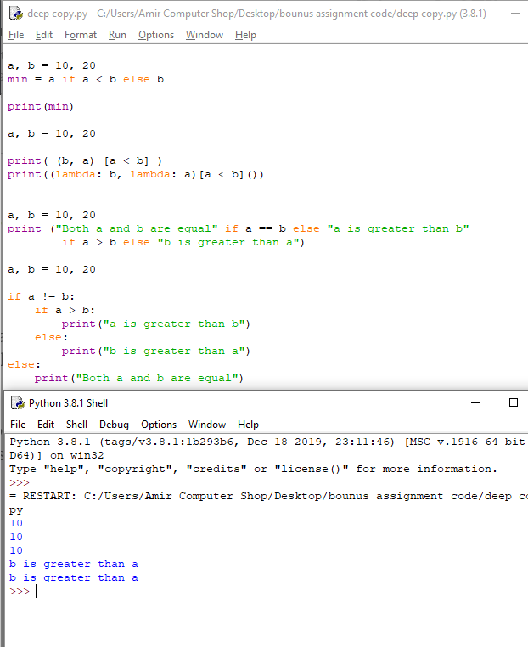
Q4.How can the ternary operations be used in Python?
Ternary operators also known as conditional expressions are operators that evaluate something based on a condition being true or false. It was added to Python in version 2.5.It simply allows to test a condition in a single line replacing the multiline if-else making the code compact.

Slide 8
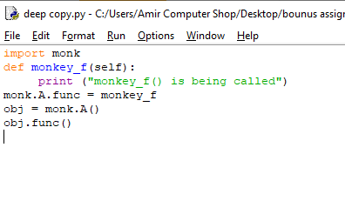

Q5.What is monkey patching in Python?
In Python, the term monkey patch refers to dynamic (or run-time) modifications of a class or module. In Python, we can actually change the behavior of code at run-time.

Slide 9
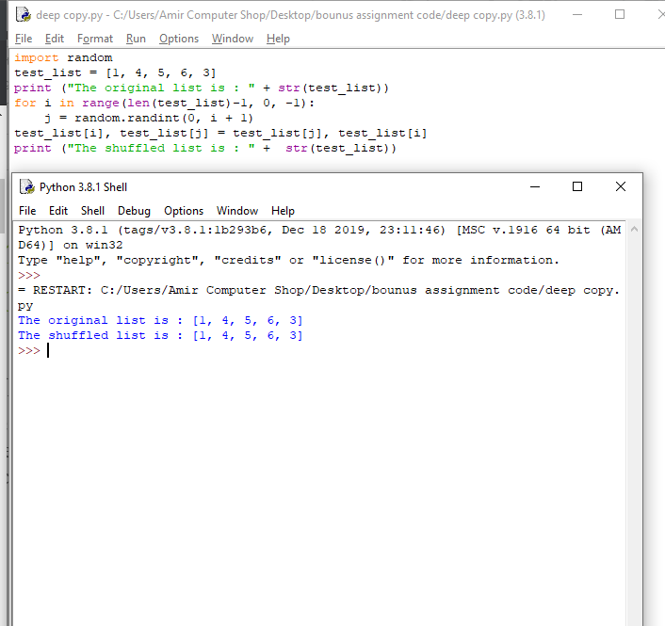
Q6.how can you randomize the items of a list in place in python?
Shuffling or randomize a sequence of numbers have always been an useful utility and the question that has appeared in many company placement interviews as well. Knowing more than one method to achieve this can always be a plus. Let’s discuss certain ways in which this can be achieved.

Slide 10
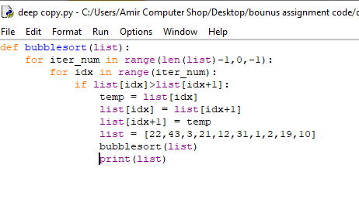
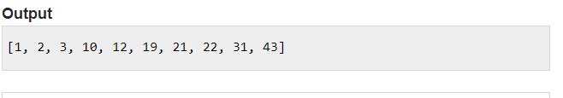
Q7.write a sorting algorithm for a numerical dataset in python?
Sorting refers to arranging data in a particular format. It makes the data more readable and the data searching can be optimized to a very high level. There are five different kinds of sorting algorithm.
Bubble sort
Merge sort
Insertion sort
Shell sort
Selection sort

Slide 11
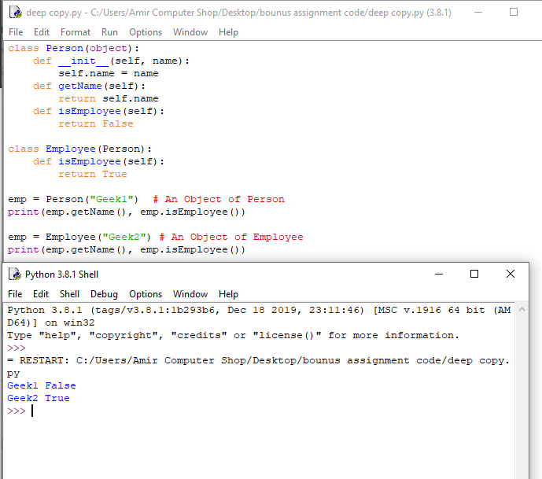
Q8.explain inheritance in python with examples?
Inheritance is the capability of one class to derive or inherit the properties from another class. The benefits of inheritance are:
It represents real-world relationships well.
It provides reusability of a code. We don’t have to write the same code again and again. Also, it allows us to add more features to a class without modifying it.
It is transitive in nature, which means that if class B inherits from another class A, then all the subclasses of B would automatically inherit from class A.

Slide 12
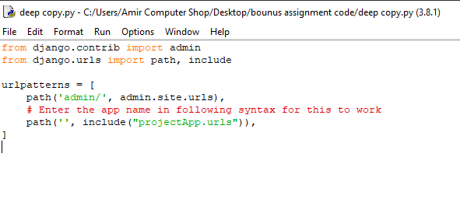
Q9.explan how you can set up the dataset in Django?
Django is a Python-based web framework which allows you to quickly create web application without all of the installation or dependency problems that you normally will find with other frameworks.
When you’re building a website, you always need a similar set of components: a way to handle user authentication (signing up, signing in, signing out), a management panel for your website, forms, a way to upload files, etc. Django gives you ready-made components to use.
(app wasn’t available that’s why haven’t added output)

Slide 13
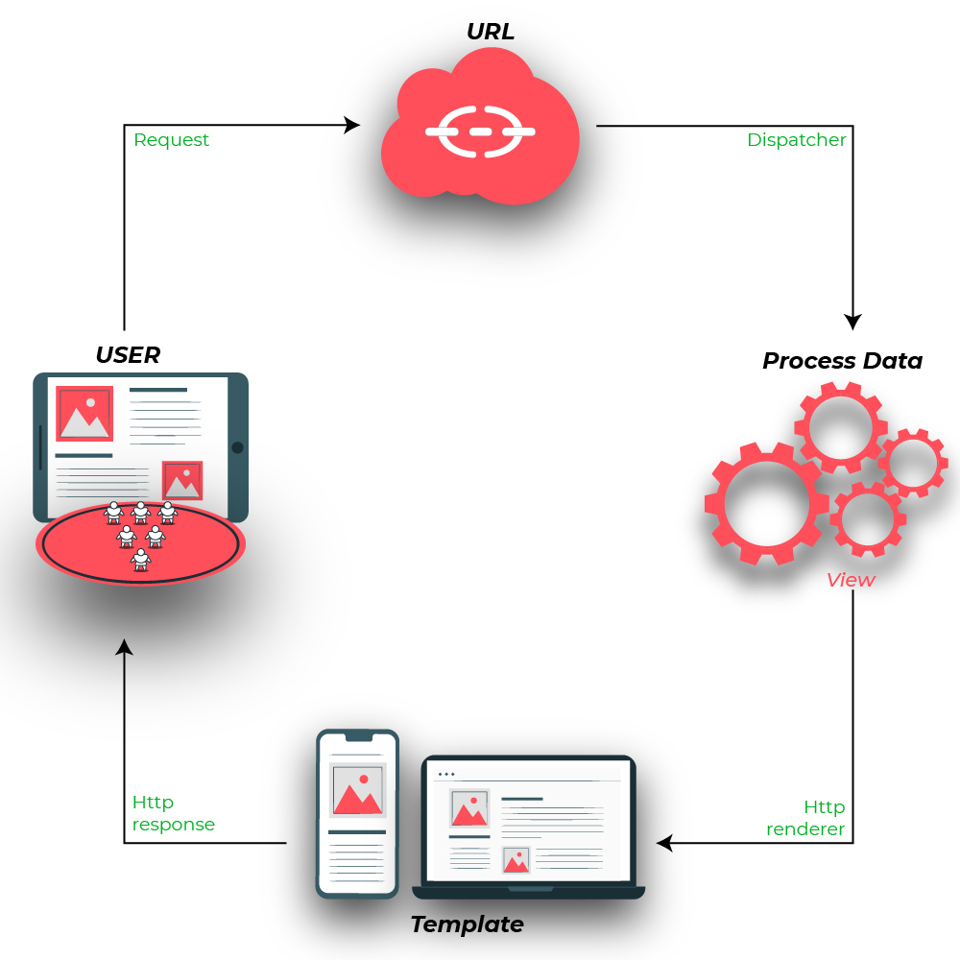
Q10.Give and example how you can write a VIEW in Django?
Django Views are one of the vital participants of MVT Structure of Django A View is the user interface — what you see in your browser when you render a website. It is represented by HTML/CSS/Javascript and Jinja files. As per Django Documentation, A view function is a Python function that takes a Web request and returns a Web response. This response can be the HTML contents of a Web page, or a redirect, or a 404 error, or an XML document, or an image, anything that a web browser can display.

Slide 14
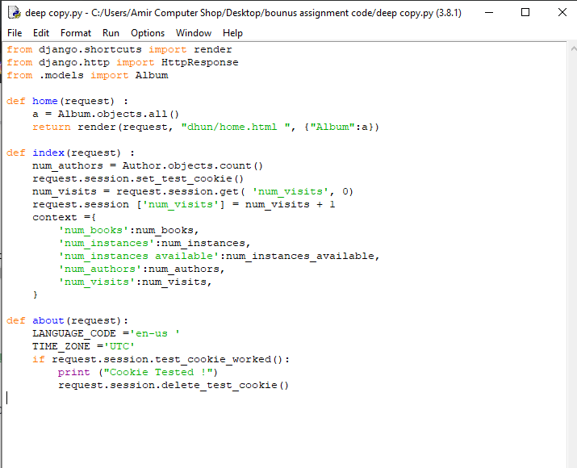
Q11.Explain the use of session in Django Framework?
All communication between web browsers and servers is via HTTP, which is stateless. The fact that the protocol is stateless means that messages between the client and server are completely independent of each other— there is no notion of "sequence" or behavior based on previous messages. As a result, if you want to have a site that keeps track of the ongoing relationships with a client, you need to implement that yourself.
Sessions are the mechanism used by Django (and most of the Internet) for keeping track of the "state" between the site and a particular browser. Sessions allow you to store arbitrary data per browser, and have this data available to the site whenever the browser connects. Individual data items associated with the session are then referenced by a "key", which is used both to store and retrieve the data.
Django uses a cookie containing a special session id to identify each browser and its associated session with the site. The actual session data is stored in the site database by default (this is more secure than storing the data in a cookie, where they are more vulnerable to malicious users). You can configure Django to store the session data in other places (cache, files, "secure" cookies), but the default location is a good and relatively secure option.

Slide 15
Thank you!

